Slide 1
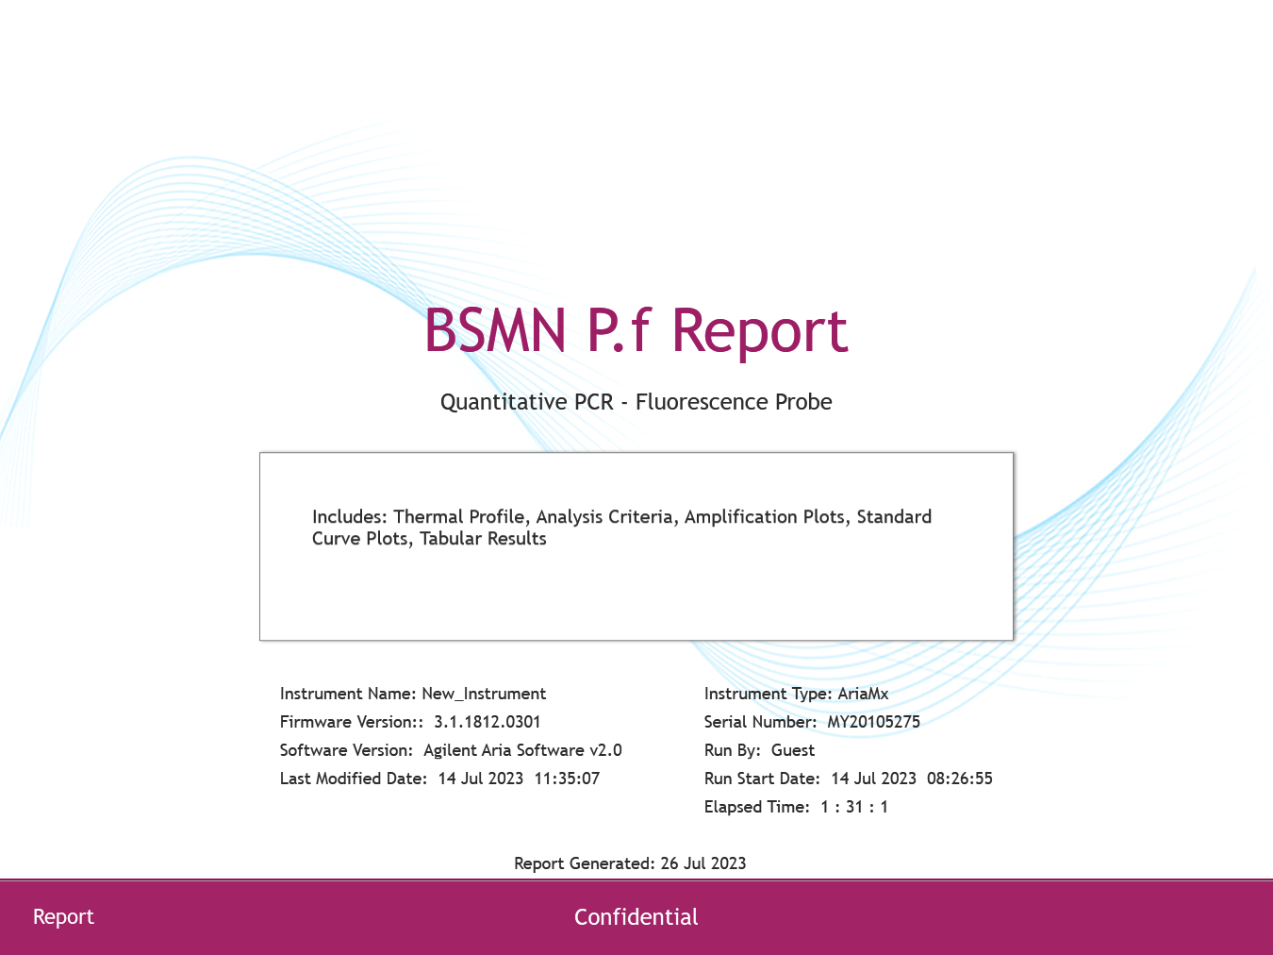

Slide 2
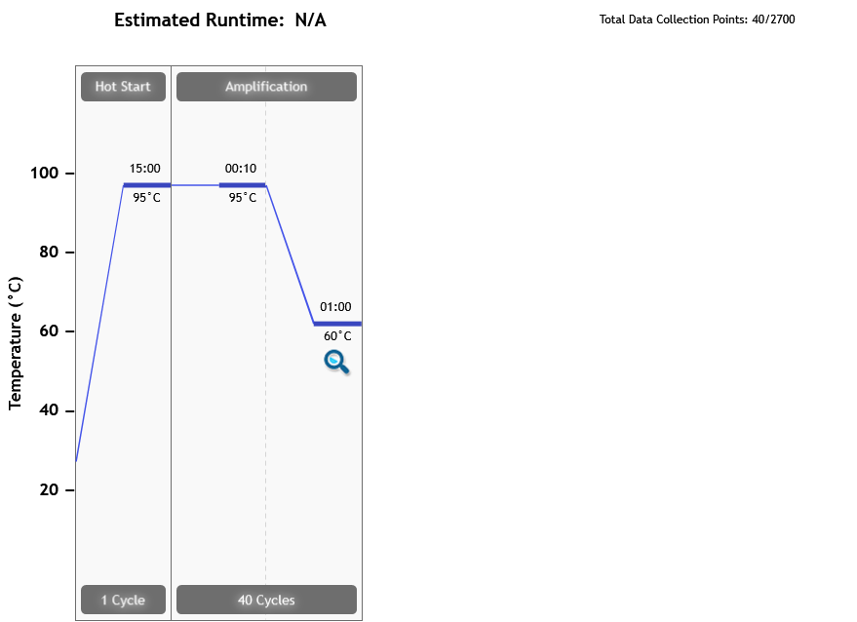
Thermal Profile
Page 2 of 9

Slide 3
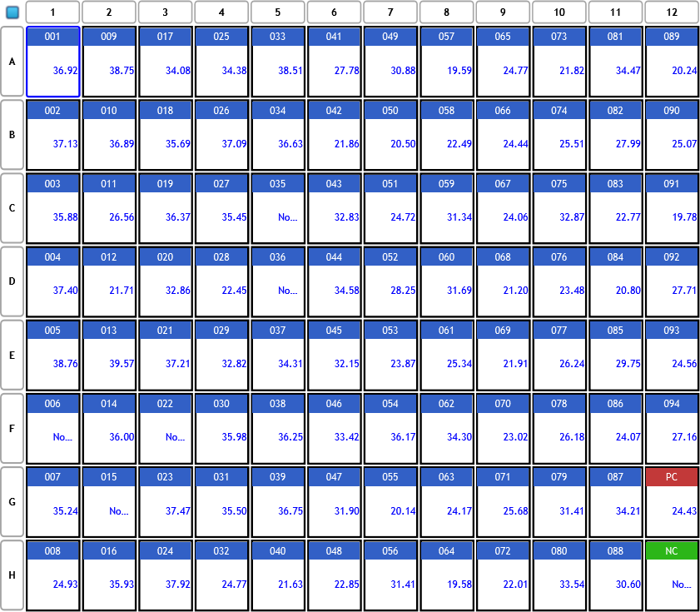
Analysis Criteria
Page 3 of 9

Slide 4
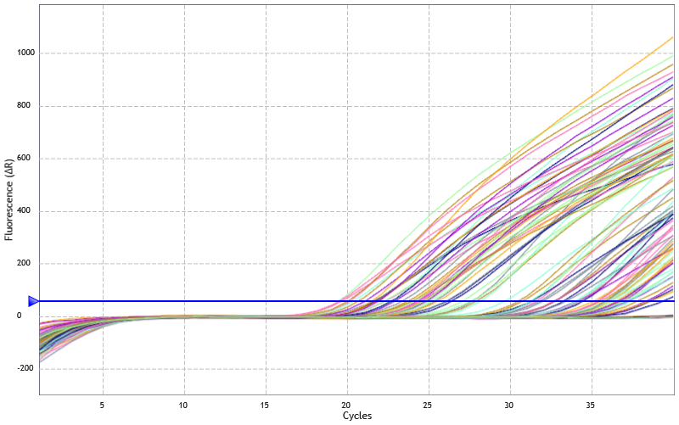
Amplification Plots
Threshold settings based on background: Start cycle = 5, End cycle = 9,
Sigma multiplier = 10, Baseline correction = Adaptive, Smoothing = On,
Crosstalk Correction: -
Page 4 of 9

Slide 5
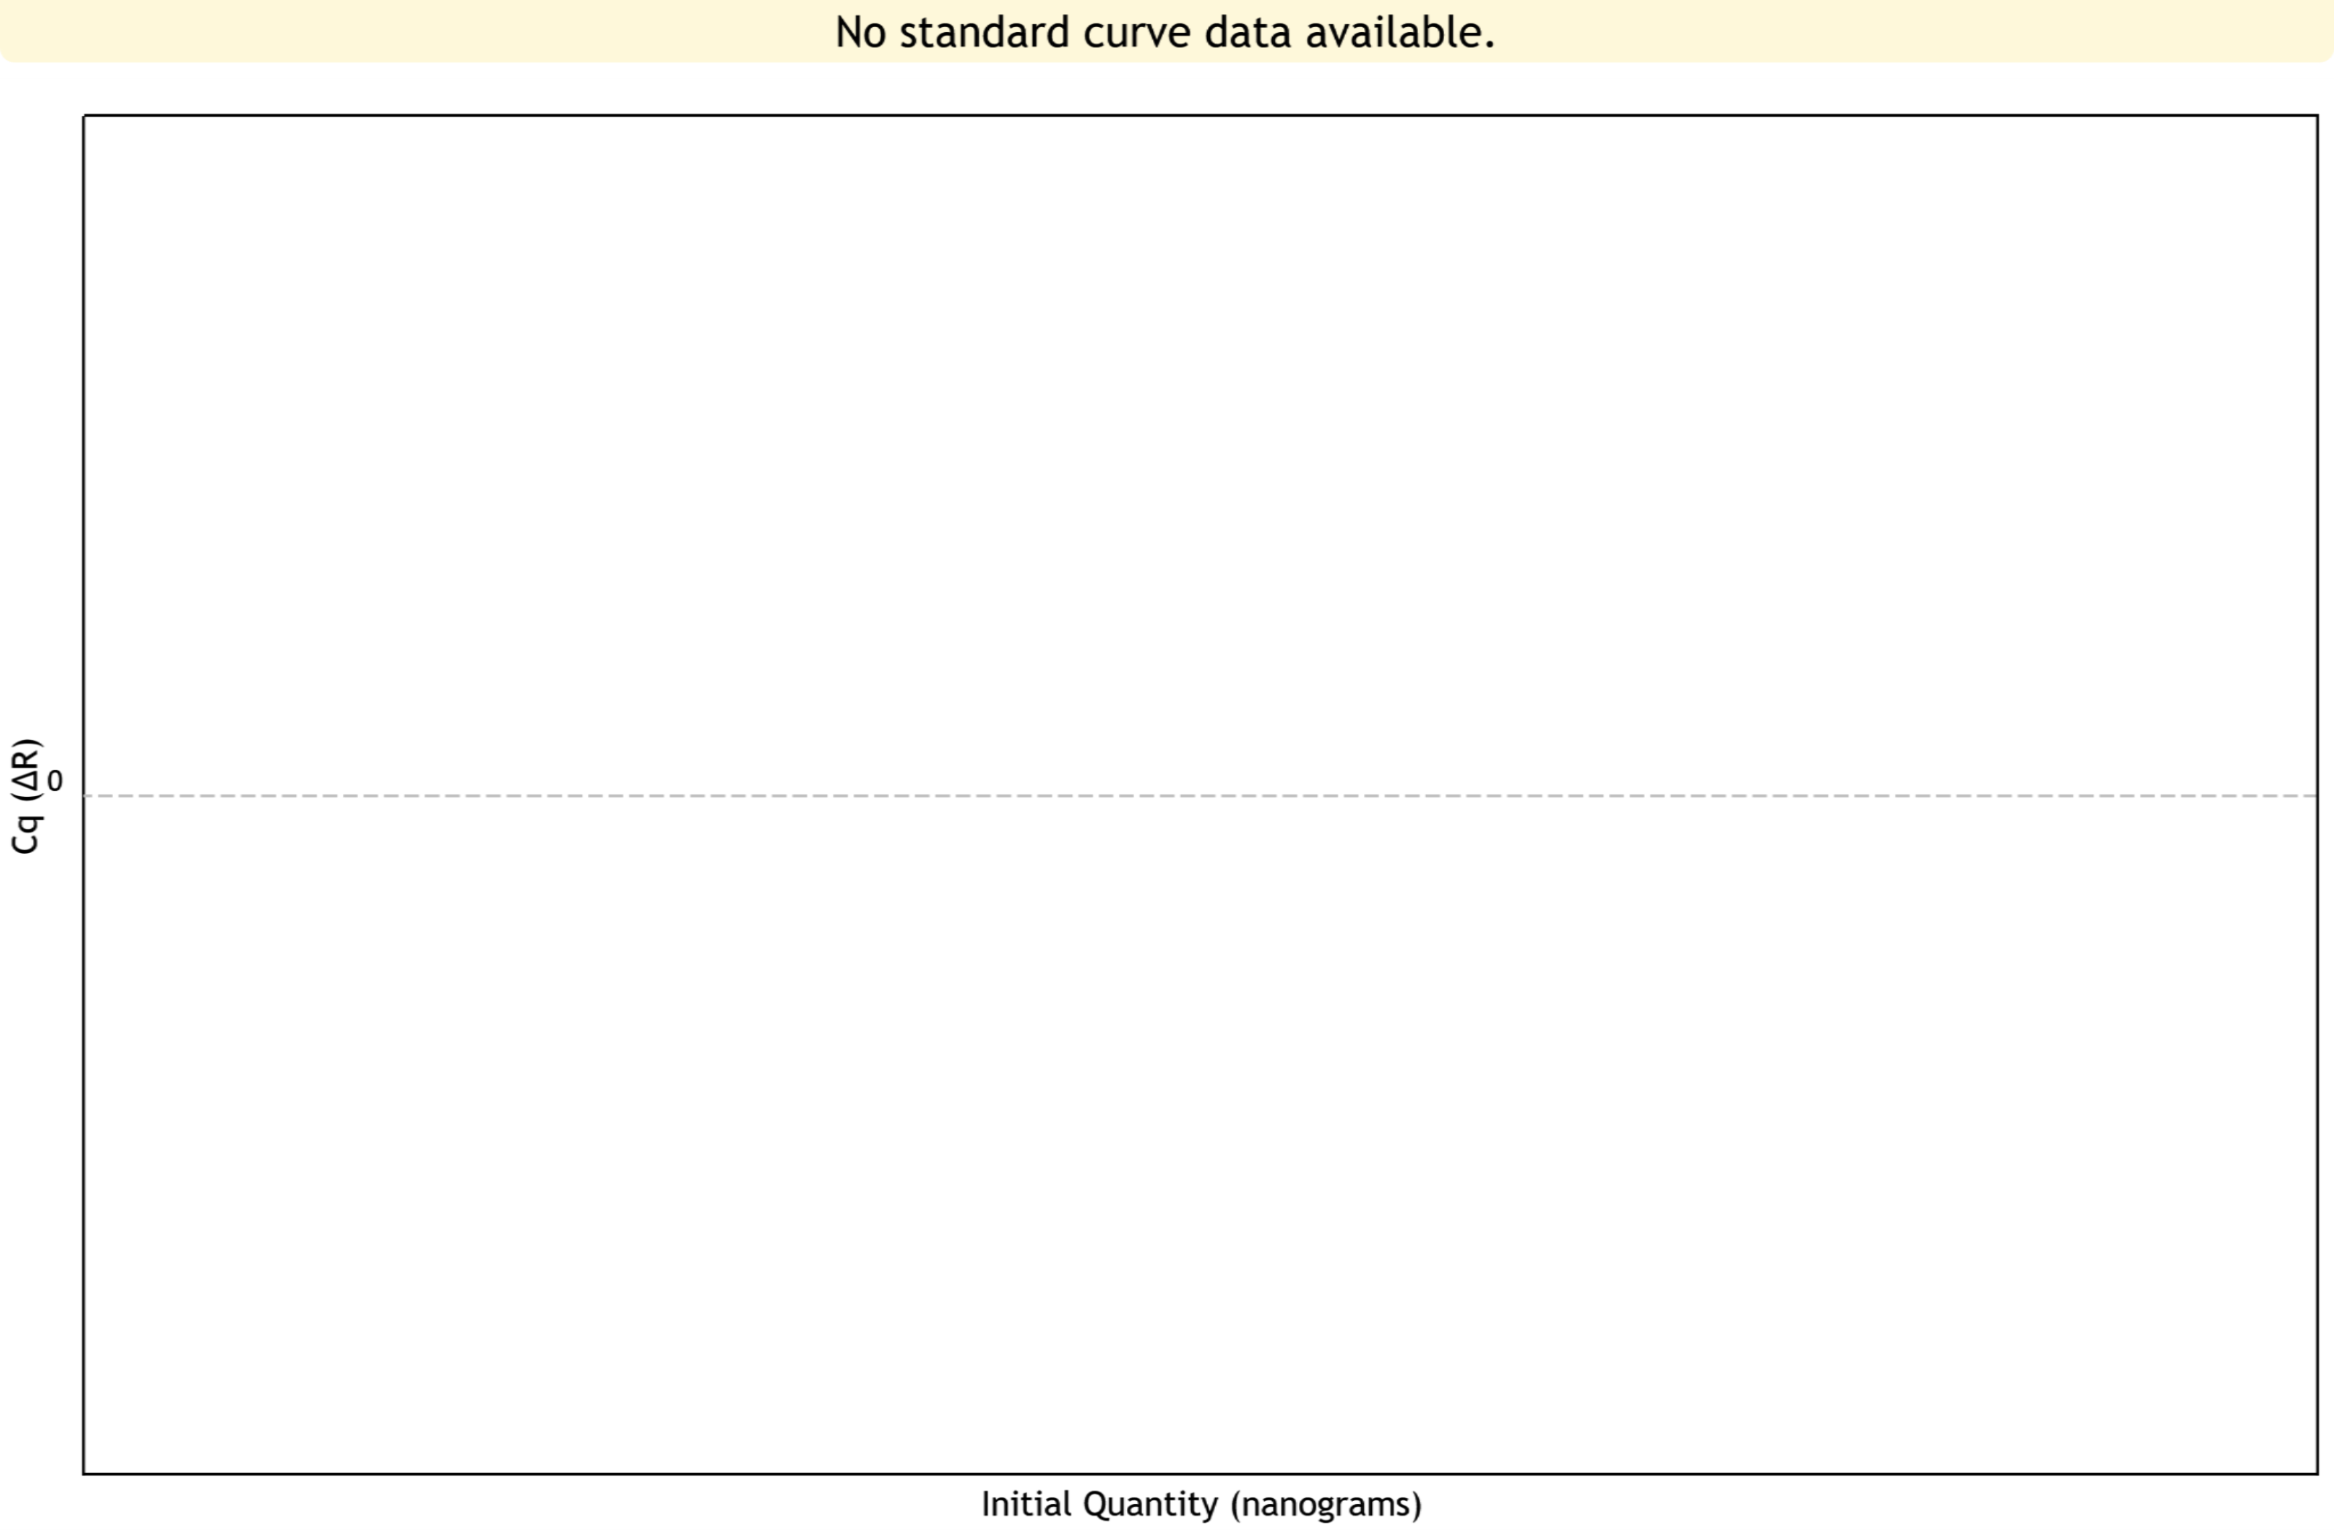
Standard Curve Plots
Confidence Level = Disabled
Page 5 of 9

Slide 6
Tabular Results (1 of 4)
Well | Well Name | Target | Cq (∆R) | Final Call (∆R)
A1 | 001 | P.falcip | 36.92 | +
A2 | 009 | P.falcip | 38.75 | +
A3 | 017 | P.falcip | 34.08 | +
A4 | 025 | P.falcip | 34.38 | +
A5 | 033 | P.falcip | 38.51 | +
A6 | 041 | P.falcip | 27.78 | +
A7 | 049 | P.falcip | 30.88 | +
A8 | 057 | P.falcip | 19.59 | +
A9 | 065 | P.falcip | 24.77 | +
A10 | 073 | P.falcip | 21.82 | +
A11 | 081 | P.falcip | 34.47 | +
A12 | 089 | P.falcip | 20.24 | +
B1 | 002 | P.falcip | 37.13 | +
B2 | 010 | P.falcip | 36.89 | +
B3 | 018 | P.falcip | 35.69 | +
B4 | 026 | P.falcip | 37.09 | +
B5 | 034 | P.falcip | 36.63 | +
B6 | 042 | P.falcip | 21.86 | +
B7 | 050 | P.falcip | 20.50 | +
B8 | 058 | P.falcip | 22.49 | +
B9 | 066 | P.falcip | 24.44 | +
B10 | 074 | P.falcip | 25.51 | +
B11 | 082 | P.falcip | 27.99 | +
B12 | 090 | P.falcip | 25.07 | +
Page 6 of 9

Slide 7
Tabular Results (2 of 4)
Well | Well Name | Target | Cq (∆R) | Final Call (∆R)
C1 | 003 | P.falcip | 35.88 | +
C2 | 011 | P.falcip | 26.56 | +
C3 | 019 | P.falcip | 36.37 | +
C4 | 027 | P.falcip | 35.45 | +
C5 | 035 | P.falcip | No Cq | -
C6 | 043 | P.falcip | 32.83 | +
C7 | 051 | P.falcip | 24.72 | +
C8 | 059 | P.falcip | 31.34 | +
C9 | 067 | P.falcip | 24.06 | +
C10 | 075 | P.falcip | 32.87 | +
C11 | 083 | P.falcip | 22.77 | +
C12 | 091 | P.falcip | 19.78 | +
D1 | 004 | P.falcip | 37.40 | +
D2 | 012 | P.falcip | 21.71 | +
D3 | 020 | P.falcip | 32.86 | +
D4 | 028 | P.falcip | 22.45 | +
D5 | 036 | P.falcip | No Cq | -
D6 | 044 | P.falcip | 34.58 | +
D7 | 052 | P.falcip | 28.25 | +
D8 | 060 | P.falcip | 31.69 | +
D9 | 068 | P.falcip | 21.20 | +
D10 | 076 | P.falcip | 23.48 | +
D11 | 084 | P.falcip | 20.80 | +
D12 | 092 | P.falcip | 27.71 | +
Page 7 of 9

Slide 8
Tabular Results (3 of 4)
Well | Well Name | Target | Cq (∆R) | Final Call (∆R)
E1 | 005 | P.falcip | 38.76 | +
E2 | 013 | P.falcip | 39.57 | +
E3 | 021 | P.falcip | 37.21 | +
E4 | 029 | P.falcip | 32.82 | +
E5 | 037 | P.falcip | 34.31 | +
E6 | 045 | P.falcip | 32.15 | +
E7 | 053 | P.falcip | 23.87 | +
E8 | 061 | P.falcip | 25.34 | +
E9 | 069 | P.falcip | 21.91 | +
E10 | 077 | P.falcip | 26.24 | +
E11 | 085 | P.falcip | 29.75 | +
E12 | 093 | P.falcip | 24.56 | +
F1 | 006 | P.falcip | No Cq | -
F2 | 014 | P.falcip | 36.00 | +
F3 | 022 | P.falcip | No Cq | -
F4 | 030 | P.falcip | 35.98 | +
F5 | 038 | P.falcip | 36.25 | +
F6 | 046 | P.falcip | 33.42 | +
F7 | 054 | P.falcip | 36.17 | +
F8 | 062 | P.falcip | 34.30 | +
F9 | 070 | P.falcip | 23.02 | +
F10 | 078 | P.falcip | 26.18 | +
F11 | 086 | P.falcip | 24.07 | +
F12 | 094 | P.falcip | 27.16 | +
Page 8 of 9

Slide 9
Tabular Results (4 of 4)
Well | Well Name | Target | Cq (∆R) | Final Call (∆R)
G1 | 007 | P.falcip | 35.24 | +
G2 | 015 | P.falcip | No Cq | -
G3 | 023 | P.falcip | 37.47 | +
G4 | 031 | P.falcip | 35.50 | +
G5 | 039 | P.falcip | 36.75 | +
G6 | 047 | P.falcip | 31.90 | +
G7 | 055 | P.falcip | 20.14 | +
G8 | 063 | P.falcip | 24.17 | +
G9 | 071 | P.falcip | 25.68 | +
G10 | 079 | P.falcip | 31.41 | +
G11 | 087 | P.falcip | 34.21 | +
G12 | PC | P.falcip | 24.43 | +
H1 | 008 | P.falcip | 24.93 | +
H2 | 016 | P.falcip | 35.93 | +
H3 | 024 | P.falcip | 37.92 | +
H4 | 032 | P.falcip | 24.77 | +
H5 | 040 | P.falcip | 21.63 | +
H6 | 048 | P.falcip | 22.85 | +
H7 | 056 | P.falcip | 31.41 | +
H8 | 064 | P.falcip | 19.58 | +
H9 | 072 | P.falcip | 22.01 | +
H10 | 080 | P.falcip | 33.54 | +
H11 | 088 | P.falcip | 30.60 | +
H12 | NC | P.falcip | No Cq | -
Page 9 of 9

